Slide 1

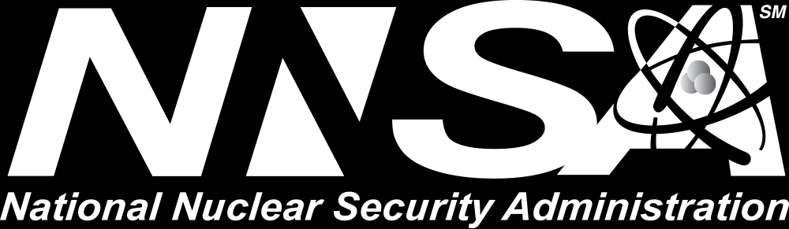
Software@Sandia

Slide 2
Windowed least-squares model reduction in Pressio
Software@Sandia Series August 24, 2020
Eric Parish and Francesco Rizzi

Slide 3
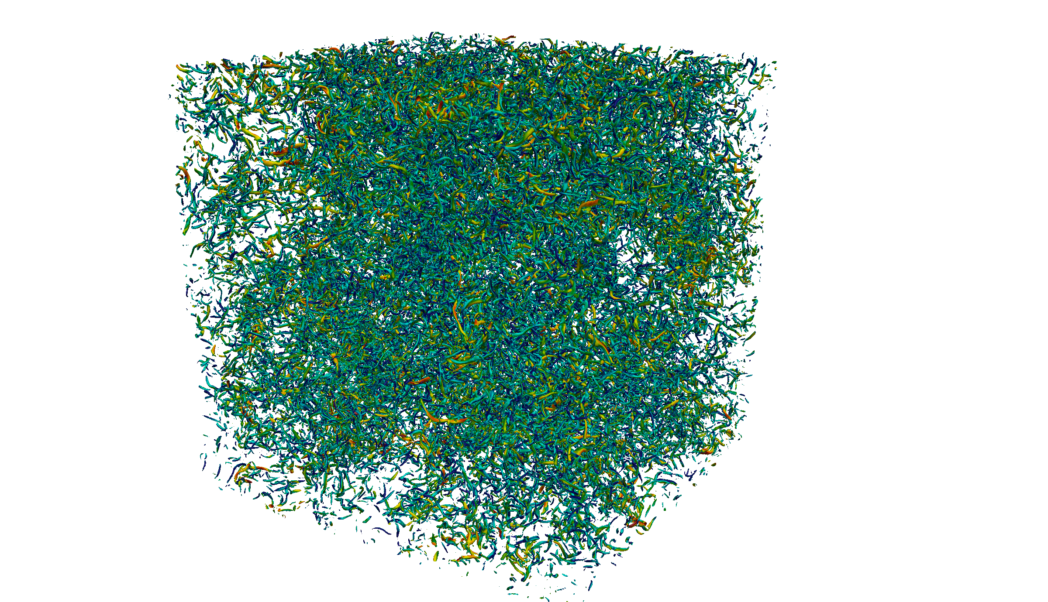
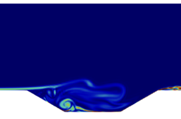
Motivation
High-fidelity full-order model simulations (FOMs) are critical to many engineering applications
FOMs incur a prohibitively high computational cost
Can require millions of hours of CPU time
Many engineering problems are time-critical or many-query by nature
Requires many evaluations of the FOM
Computational cost of the FOM is a bottleneck
Projection-based reduced-order models provide a solution
Enable accurate approximate solutions at a low computational cost
High fidelity simulation of homogeneous isotropic turbulence
High-fidelity simulation of cavity flow

Slide 4
What are projection-based ROMs?
Projection-based ROMs (pROMs) are data-informed methods
Operate by projecting governing equations onto low-dimensional subspaces
pROMs use basis functions constructed from data
Involves solving the governing equations
Other types of ROMs:
Data-centric surrogate models: create a purely data-driven surrogate model
Reduced fidelity/physics models: use coarse meshes and/or reduced physics

Slide 5
Brief description of projection-based ROMs
We focus on the dynamical system
pROMs involve the following steps:
Solve the FOM to obtain “training data”
Identify low-dimensional structure (subspace) within the training data
Project the FOM onto the low dimensional subspace
Solve the pROM for new predictive cases

Slide 6
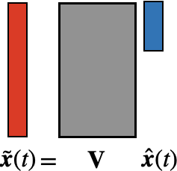
Data-driven subspaces
Trial subspaces in pROMs are identified empirically
Generation process: Query the full-order model for select parameter instances to generate sample trajectories
Use simulation data to identify low-dimensional structure
E.g., principle component analysis
Results in the approximation:

Slide 7
Building the ROM
Insert our approximation into the governing equations:
N equations for K unknowns (K << N)
Various techniques exist to reduce the system dimension
Galerkin method
Least-squares Petrov—Galerkin method (LSPG)
Windowed least-squares method (WLS)
Example: Galerkin method
Restricts the residual to be orthogonal to
Results in the K dimensional system
Galerkin method can be unsteady for nonsymmetric problems

Slide 8
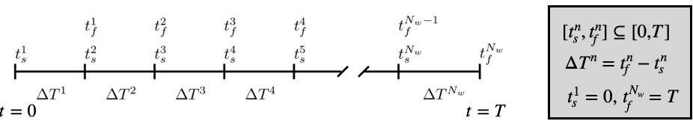
Windowed least squares ROM
Decompose the time domain into windows
Over each window, define an objective functional that measures the residual
Sequentially solve a minimization problem over each window
Residual minimization formulation yields enhanced stability

Slide 9
Solving the minimization problem
Step 1: discretize the state into instances
Step 2: discretize the objective functional
Step 3 : solve the discrete least squares problem

Slide 10
Key Challenges
Projection-based ROMs are intrusive
Commonly, ROMs are implemented directly in the application code
Highly intrusive: changes to application code
Not extensible: individual ROM implementation for each application
Access requirements: developers need direct access to application
Motivates Pressio

Slide 11
Pressio
A computational framework aimed at providing performant pROMs to generic application codes
Open source code developed at Sandia:
Lead developer: Francesco Rizzi
Team: Patrick Blonigan, Eric Parish, Kenny Chowdhary, John Tencer, …
Former developers: Kevin Carlberg and Mark Hoemmen
Main idea:
Delineate between the “application” and the ROM
ROM methods are contained in the Pressio framework
Pressio “plugs in” to an application code
rom
https://github.com/Pressio

Slide 12
High-level features
Header-only C++11 library
Benefits portability
Leverages C++11 and metaprogramming for type detection and compile-time dispatching
Supports HPC programming models (e.g., Kokkos, tPetra)
Support for GPU computing via Kokkos
Supports a Python API
Enables Python users to use Pressio
Supports Galerkin, LSPG, and WLS ROMs (w/ hyperreduction)

Slide 13
How does Pressio talk to an application?
Pressio’s API requires the application to expose two main functions:
veloctiy:
applyJacobian:
rom
Pressio uses these functions to construct the ROMs
For hyper-reduction, we require velocity and applyJacobian to return results at only a subset of the mesh

Slide 14
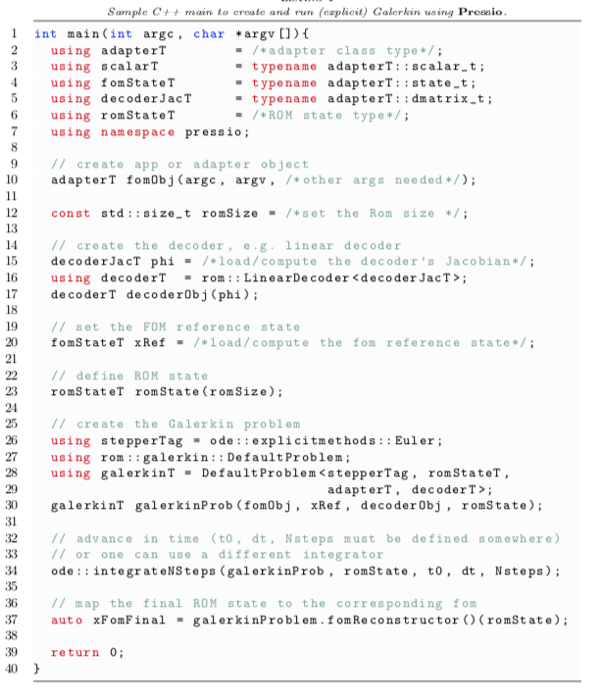
Pressio: How do we build and run a ROM?

Slide 15
Example application of Pressio: Overview
Construct a ROM of the shallow water equations
Initial conditions
System parameters:
: gravity parameter
: controls the magnitude of the pulse
Surface plot of the water height

Slide 16
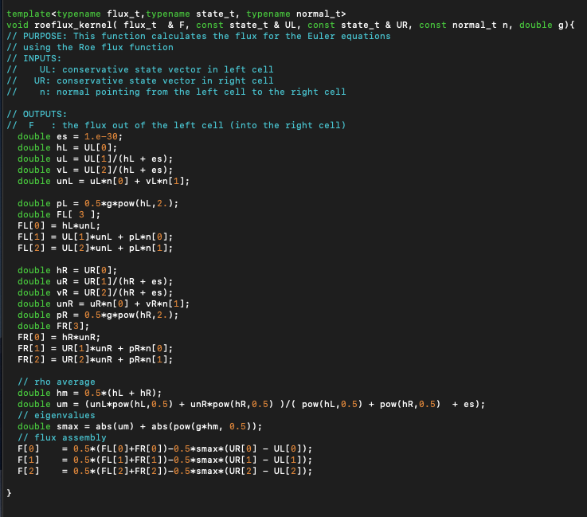
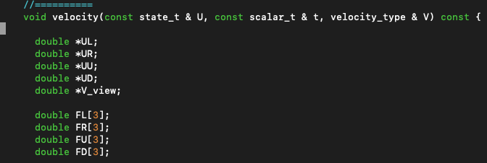
Example application of Pressio
Have access to an app that solves the shallow water equations
1st order finite volume scheme
128 x 128 mesh
tPetraBlock data structures
Capable of evaluating residual at a subset of the mesh
Takes 5 minutes to run one simulation
Add functionality for the app to meet Pressio’s API
Expose velocity and applyJacobian functions
Shallow Water App
Execute FOM for training parameter instances
Expose “velocity” function to meet Pressio API

Slide 17
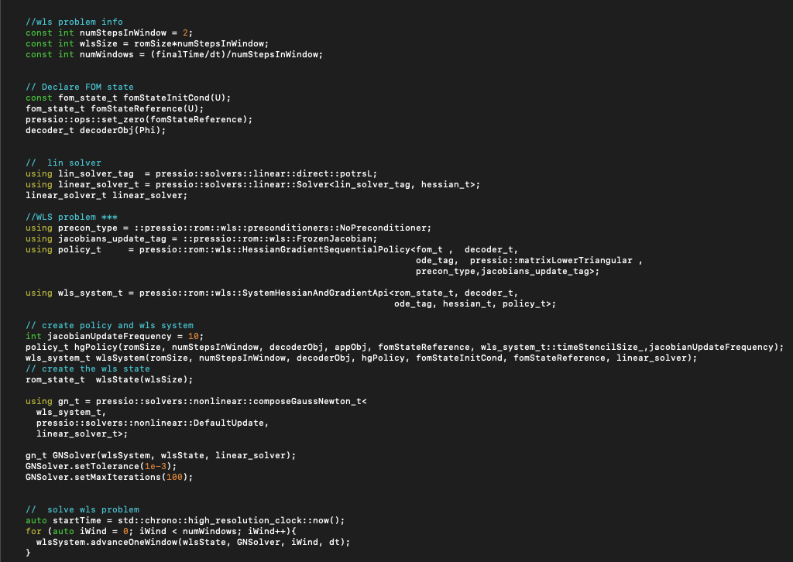
Example application of Pressio
Construct ROM basis from FOM data
External to Pressio
For hyper-reduction
Identify FOM cells at which to evaluate the residual
Write main file for ROM application using Pressio
Read in basis
Declare problem information
Execute ROM app and post process data
Post processing is external to pressio
Sample “main” file for WLS in pressio

Slide 18
Results
Results at a novel parameter instance
0.3% error
8x speed up over FOM
6x better than nearest neighbors solution
Results improve as the FOM dimension grows

Slide 19
Conclusions
Projection-based ROMs enable fast and efficient approximate solutions
The windowed-least squares formulation enables particularly robust solutions
Pressio is an open-source framework developed at Sandia aimed at providing performant pROMs
Freely available on github
Header only C++11 library
Supports arbitrary datatypes and HPC programming models
Supports a Python API
We are growing the Pressio project
Coupling to new application codes
Adding new solvers and ROM techniques
Improving user interfaces and APIs

Slide 20
Software Points of Contact
https://github.com/Pressio
Contact email for Pressio: fnrizzi@sandia.gov
Contact email for WLS implementation: ejparis@sandia.gov

Slide 21
Backup slides

Slide 22
High-level features
Header-only library, no need to be compiled and packaged
Benefits portability
Modular structure
Packages are designed to be self-contained with minimal inter dependencies
Benefits the development cycle and extensibility
Relies on modern C++11 and metaprogramming for type detection and compile-time dispatching
Support for state-of-the-art HPC programming models (e.g. Kokkos)
Seamless support for GPU computing via Kokkos
Unit and regression tests with continuous integration (growing feature)
Supports a basic Python API to expose the C++ ROM functionalities
Enables Python users to use Pressio

Slide 23
Interfacing with simulation codes
Traditionally, pROM methods are implemented directly in each application code
Highly intrusive: major changes to application code
Not extensible: individual ROM implementation for each application
Access requirements: developers need direct access to application
Pressio: computational framework addressing all these issues:
Minimally intrusive API
Facilitates contributions from external partners
Open Source!
Clear separation between methods and application
Enables methods work without access to restricted applications
Schematic of Pressio software workflow

